Slide 1
Building, Hosting, and Securing a Web Application
Using Microsoft Azure, Docker, and GoDaddy
Notes:
Hello everyone.Today i will be discussing about My project which is Building, Hosting, and Securing a Web Application using Microsoft Azure , docker and Godaddy.

Slide 2
Project Objectives
Built and deployed a cloud-hosted cybersecurity website.
Configured a custom domain and encrypted HTTPS access
Implement Azure security controls and cloud security review
Explored web security and backup recovery.
Notes:
I developed a cybersecurity portfolio and blog, deployed it using Docker and Apache, connected a custom GoDaddy domain, and secured access using HTTPS. I also worked with Azure Web Application Firewall and Microsoft Defender for Cloud. In the upcoming slides,. I'll briefly explain the architecture, security features, and the main lessons learned.

Slide 3
Cloud Architecture and Deployment
Key Details:
GoDaddy DNS
shammacybersecurity.info
Resource Group: Cybrbee
Web App: ShammaSecurityResume
Domain: shammacybersecurity.info
Azure Region: Central India
Docker image: cyberxsecurity/project1-apachewebserver
DNS ownership: A + TXT records
Site editing: Azure SSH
Azure App Service
Cloud hosting and Custom Domain
Docker + Apache
Containerized web server
HTML and CSS
Cybersecurity Blog Content
Notes:
First, I created an Azure App Service within my resource group named Cybrbee, using the Central India region. My web application is named ShammaSecurityResume.
I registered the custom domain shammacybersecurity.info through GoDaddy and configured A and TXT DNS records to connect the domain to Azure and verify ownership.
Next, I deployed a Docker container using the cyberxsecurity Apache web server image. Apache serves my cybersecurity blog, which I customized using HTML and CSS.
Then I accessed the container through Azure SSH to edit the website files directly. This architecture allowed me to host a customized web application on Azure with my own domain

Slide 4
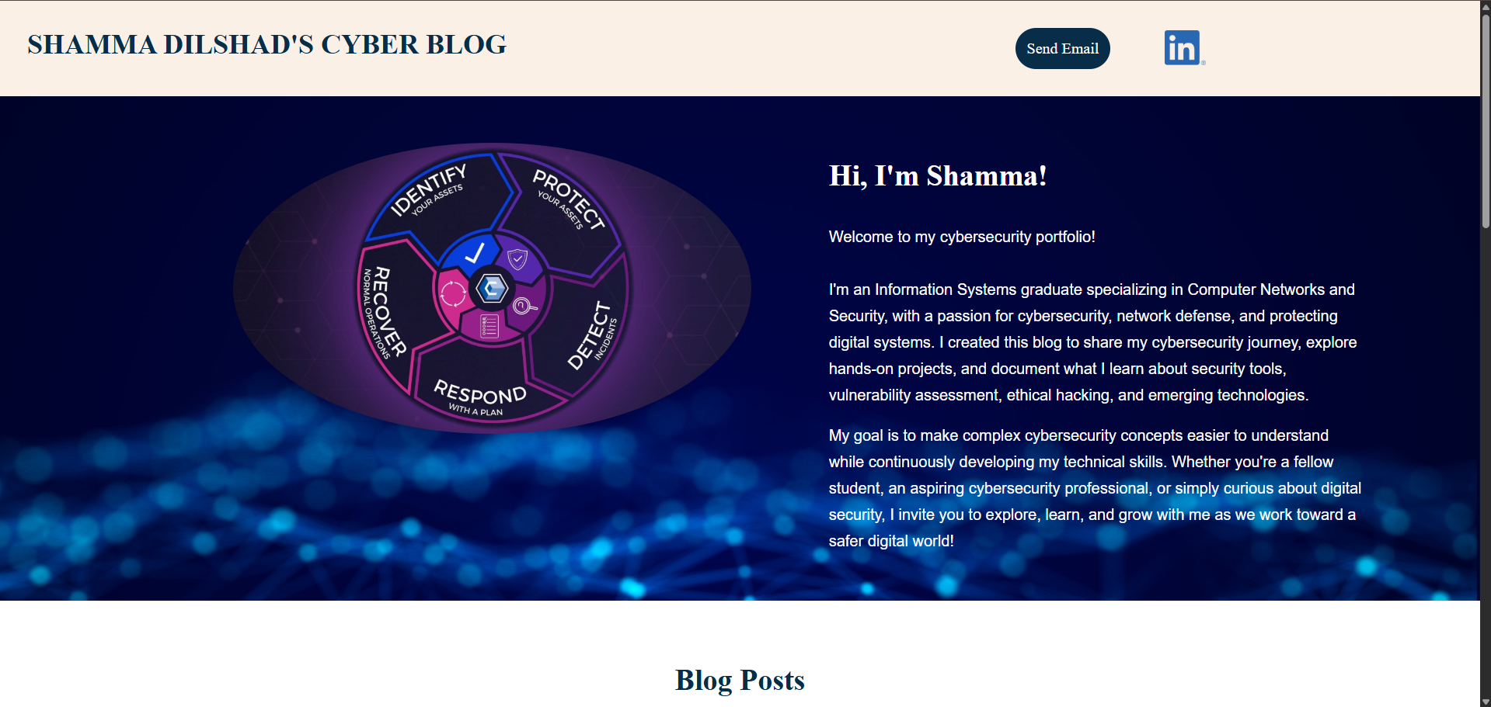
Website Design and User Experience
Introduction:
Notes:
After deployment, I customized the website with HTML and CSS where I have changed my name, email. linkedIn profile link and also edited the portfolio.

Slide 5
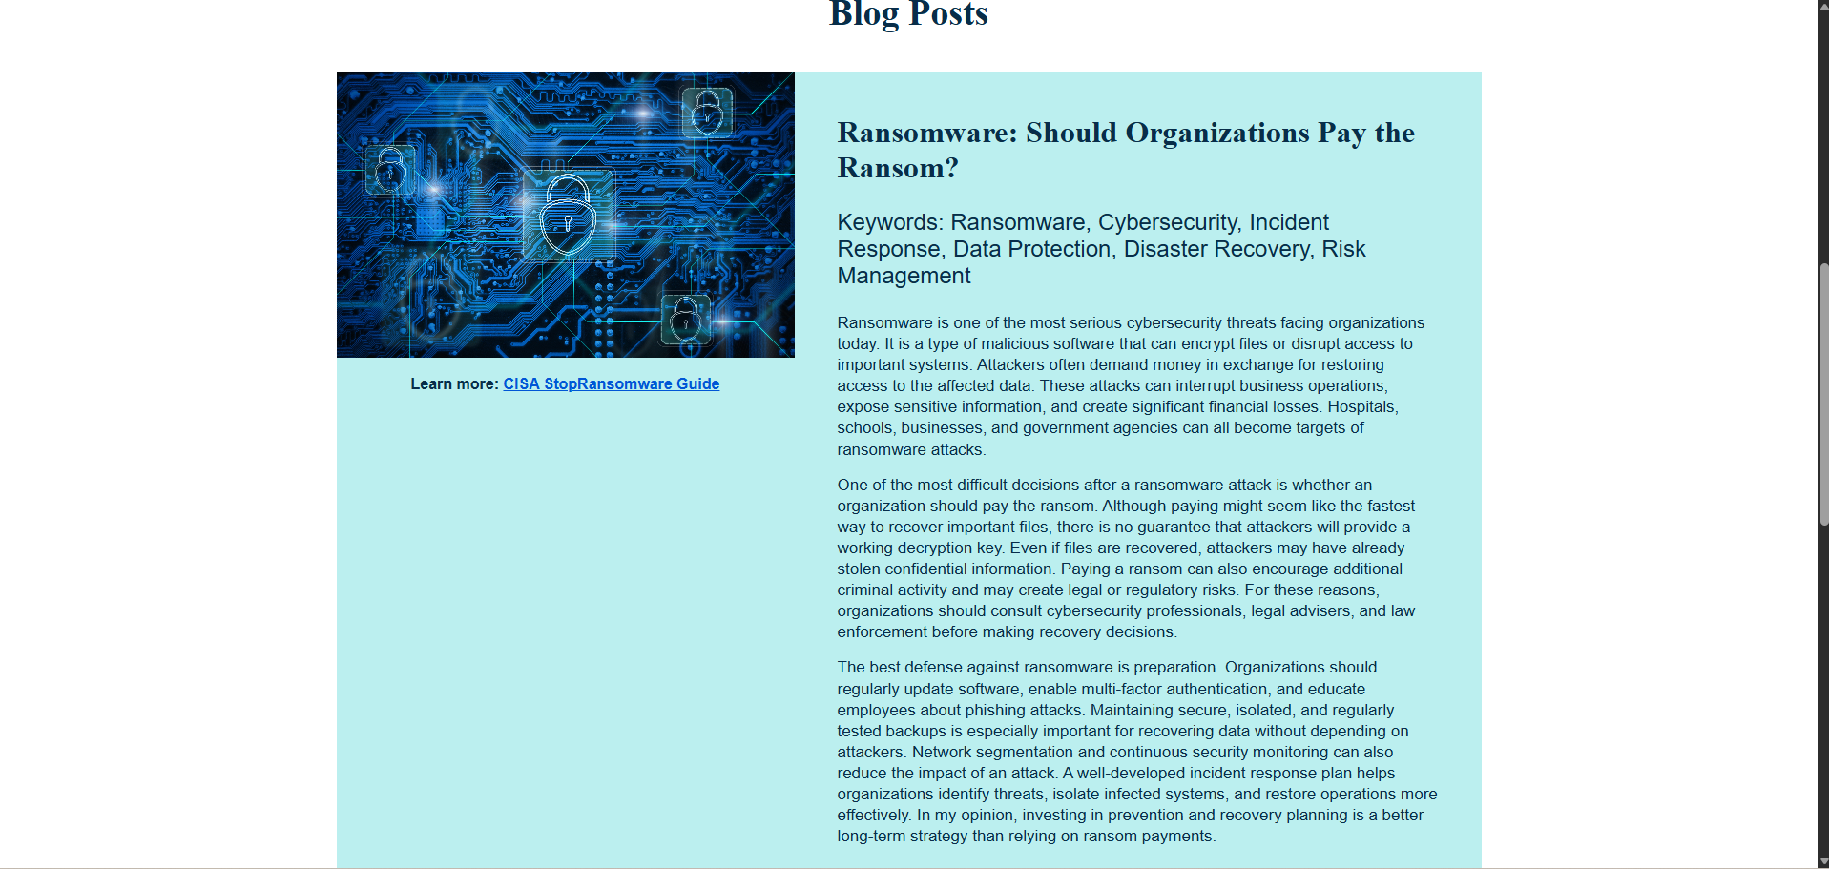
Cyber Security Content
Notes:
I also published two cybersecurity blog posts: one discusses whether organizations should pay ransomware demands, and the other explains network security monitoring and early threat detection. I added images, navigation, links to educational resources, and contact information.

Slide 6
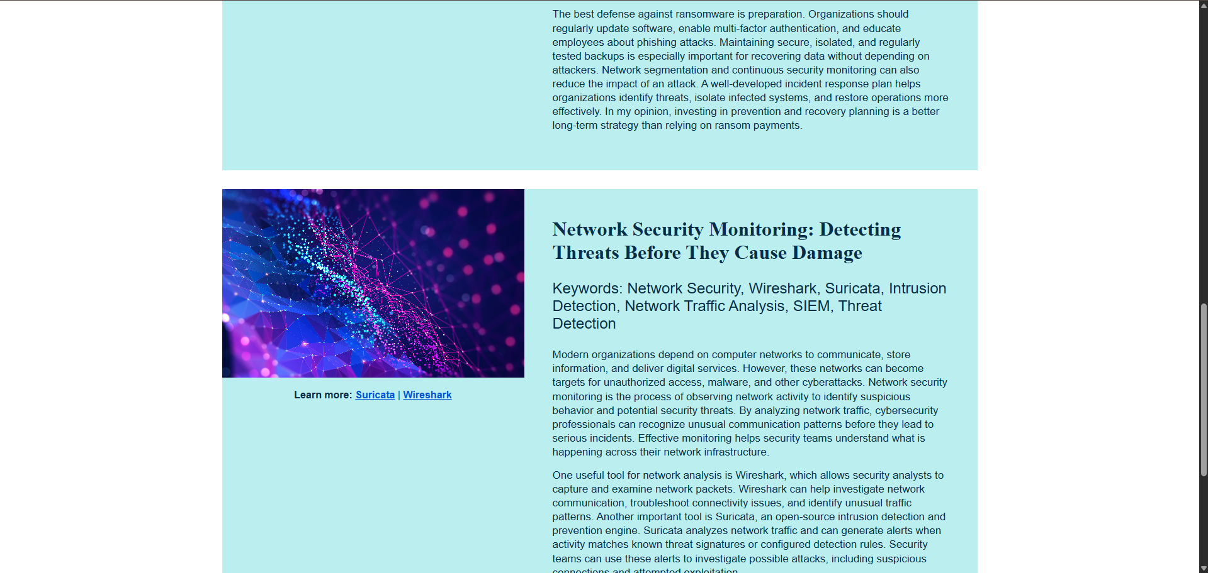
Continued..

Slide 7
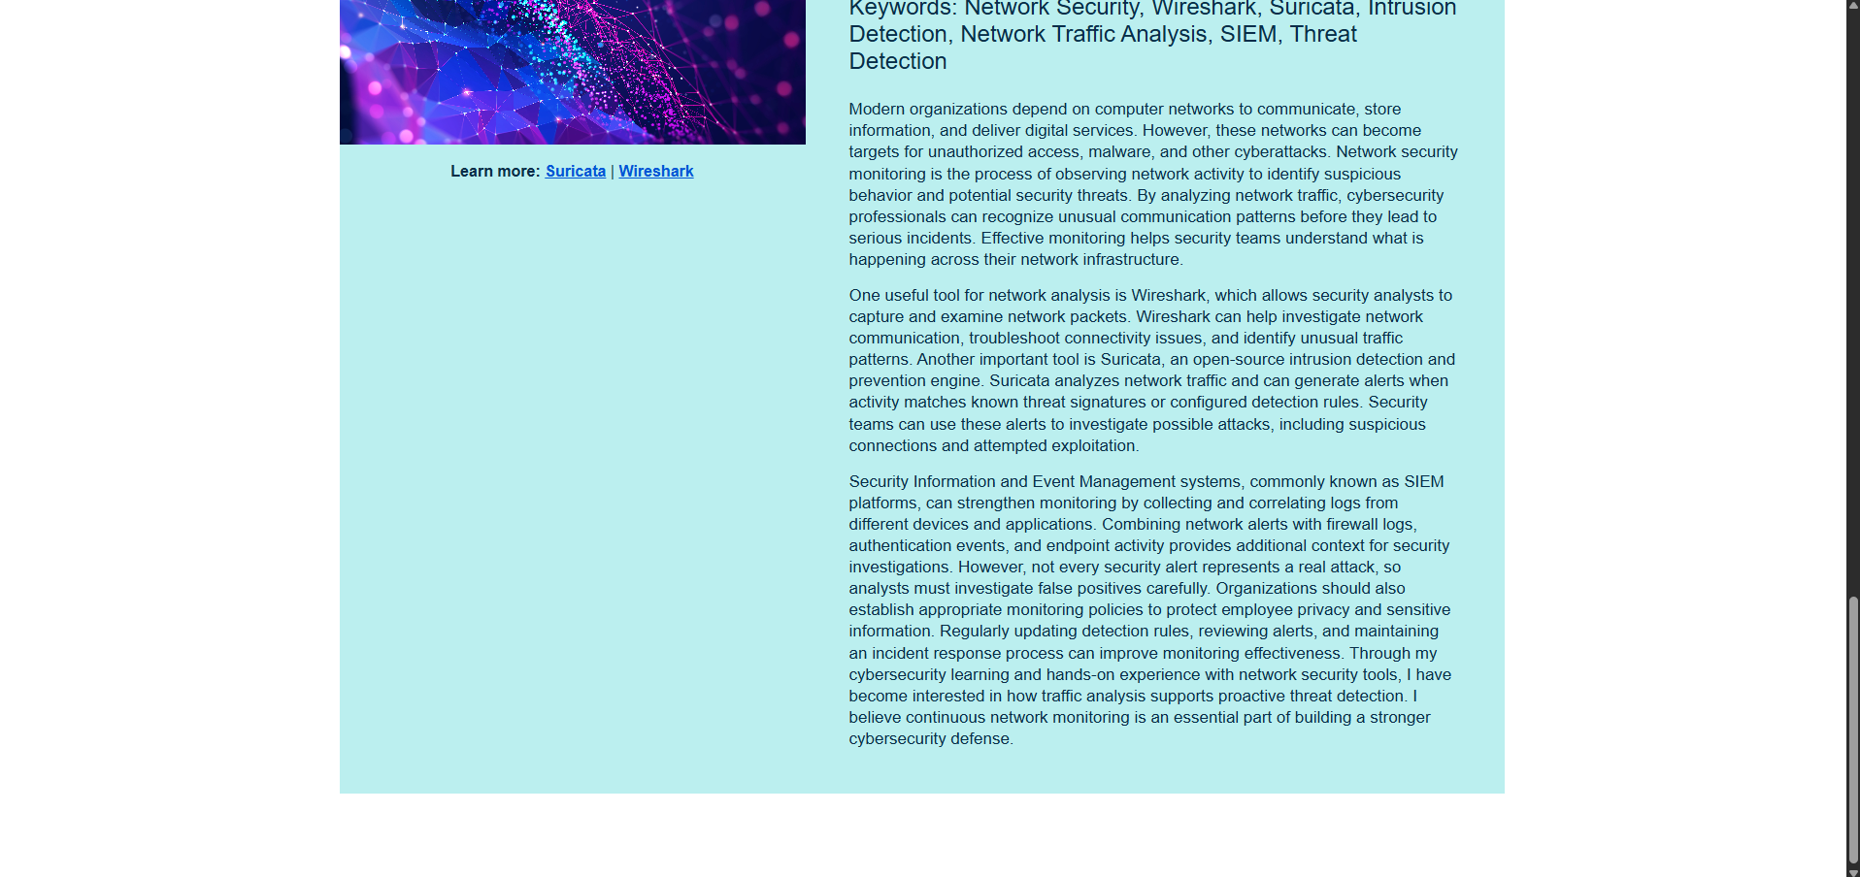
Continued..

Slide 8
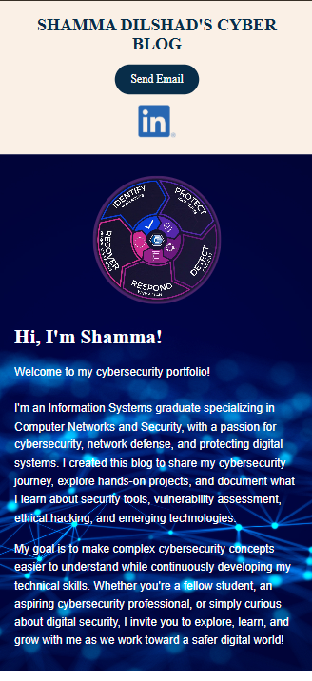
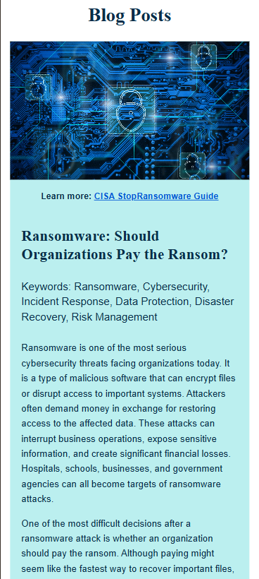
Responsive Design
Customized index.html and style.css file.
Used CSS flexbox for flexible layouts.
Media queries at 1024px and 600 px
Tested different device views
Notes:
I also improved the responsive design using Flexbox and media queries at 1024 and 600 pixels, so the layout adapts to desktop and mobile screens. I tested and corrected issues with image sizing and content alignment.

Slide 9
Application Security and Threat Protection
SSL/TLS
Azure key Vault and OpenSSL
Self Signed Certificate + PFX
Trusted Certificate & SNI SSL
HTTPS for Custom Domain
Web Application Firewall (WAF)
Reviewed managed WAF rules
Created Custom Rule: Project1rule
Priority 100; Geo Location
Deny outside US, Canada, Australia
Defender for Cloud
Reviewed security recommendations
Assessed configuration risks
Notes:
Security was a major part of this project. I created an Azure Key Vault and used OpenSSL(Secure sockets layer) to generate a self-signed certificate.then, I converted the certificate into PFX(Personal Information Exchange) format and worked with Azure certificate import and binding. In the next step, I compared self-signed certificates, which can trigger browser trust warnings, with trusted certificates. After that, I configured trusted HTTPS access using an SNI SSL binding for my custom domain.
Then came the Azure Web Application Firewall. I reviewed its managed rule sets, which are designed to identify common web attacks, and created a custom rule called Project1rule with priority 100. The rule uses geographic location based on the remote address and denies traffic outside the United States, Canada, and Australia. Finally, I reviewed Microsoft Defender for Cloud recommendations to identify configuration risks and address applicable security findings. These controls illustrate encryption, filtering, and security monitoring as complementary layers.

Slide 10
Troubleshooting, Backup and Recovery
Challenge: Temporary container files (Website edits maybe lost after restart)
Solution: Persistent /home storage ( Backup index.html and style.css to home)
Day 1 backup and restore workflow:
cp /var/www/html/index.html /home & cp /var/www/html/assets/css/style.css /home → Backup edited html and css file
cp /home/index.html /var/www/html → Restore the file
/home persists across container restarts → Protect site edits
Refresh website after restoration
Notes:
The Day 1 project instructions emphasized the importance of backing up HTML and css changes because files edited inside a running Docker container can be lost after a restart or replacement. I followed the recommended Linux copy-command method. After updating the site, I copied the index.html file and style.css from the Apache web directory to persistent /home storage . If the edited page is lost, I can restore it from /home storage and refresh the website. This taught me the distinction between temporary container files and persistent App Service storage.

Slide 11
Project Outcomes and Key Takeaways
Cloud Deployment: Successfully hosted a functional cybersecurity website using Azure App Service and Docker.
Web Security: Secured web communication using SSL/TLS certificates and HTTPS.
Threat Protection: Configured Azure WAF rules to restrict unauthorized geographic traffic.
Security Assessment: Evaluated Microsoft Defender for Cloud recommendations.
Data Protection: Implemented website backup and restoration using persistent Azure storage.
Web Development: Created a responsive cybersecurity blog using HTML and CSS.
Key Takeaways
Gained hands-on experience with cloud infrastructure and application security.
Strengthened Linux command-line, troubleshooting, and configuration skills.
Developed a better understanding of securing and maintaining cloud-hosted applications.
Notes:
This project provided practical experience in deploying and securing a cloud-hosted web application. I learned how to integrate Azure App Service with Docker, configure SSL certificates, and use Web Application Firewall rules to control incoming traffic. I also explored cloud security recommendations. Overall, the project strengthened my technical skills in cloud security, Linux administration, web development, and troubleshooting cloud hosted application .

Slide 12
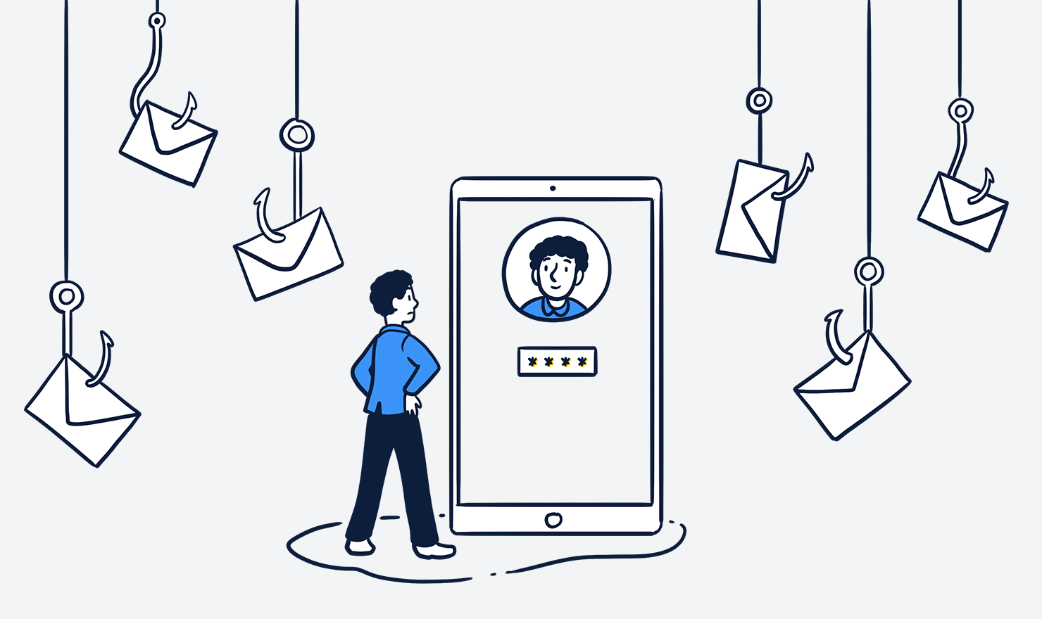
Thank You!

